Slide 1
VMware Pro Cloud Services for Private Cloud
Design Workshop

Slide 2
Private Cloud Conceptual and Logical Design
Security Architecture Pattern
Philosophy and Approach
Layered Defenses
What’s New
Removals and Changes
Methodology
Resources

Slide 3
VMware Pro Cloud Services
Private Cloud Conceptual Design

Slide 4
VMware Pro Cloud Services for Private Cloud
Conceptual overview
Multi-Tenant Consumers and Services
LOBs
Devs and SREs
Platform Teams
Integrations and 3rd Party Ecosystem
Consumption
Self-Service Portal
API | CLI | CI/CD
Infra-as-Code
Security Governance and Compliance
Data Protection
and Recovery
Data Services
App Runtime Services
AI/ML Services
LBaaS Services
Identity and RBAC
IaaS | CaaS | PaaS | XaaS
Data Protection
Auditing and SIEM
Disaster Recovery
Automated Operations
Constraint-Based Management
Performance Optimization
Visibility and Observability
Analytics and Reporting
Disaster Avoidance
Data Governance
Cost Efficiency Management
Capacity Management
Configuration Management
Ransomware Recovery
Compliance Enforcement
Virtualized Infrastructure
Compute
Storage
Network
Any Hardware
Notes:
Talk Track:
This slide outlines the key elements that constitute a modern private cloud. The core pillars—Security Governance and Compliance, Management, Automated Operations, Data Protection and Recovery, and Virtualized Infrastructure—form the backbone of the private cloud. While the specific sub-components can be tailored to meet different needs, the general construct remains the same. This flexibility allows organizations to build a private cloud that is secure, efficient, and resilient, tailored to their specific requirements. Security Governance and Compliance
• Identity and RBAC (Role-Based Access Control): Ensures secure access management.
• Auditing and SIEM (Security Information and Event Management): Provides monitoring and auditing capabilities.
• Constraint-Based Management: Enforces policies and constraints for compliance.
• Data Governance: Manages data integrity and privacy.
• Compliance Enforcement: Ensures adherence to regulatory standards.
Management
• Self-Service Portal: Allows users to access and manage resources independently.
• API | CLI | CI/CD: Facilitates automation and integration through various interfaces.
• Infra-as-Code: Enables infrastructure management through code for consistency and repeatability.
• Data Services: Manages data storage and retrieval.
• App Runtime Services: Provides environments for running applications.
• AI/ML Services: Supports artificial intelligence and machine learning workloads.
• LBaaS Services: Offers Load Balancer as a Service for optimal traffic distribution.
Automated Operations
• Performance Optimization: Enhances system performance.
• Visibility and Observability: Provides insights into system health and operations.
• Analytics and Reporting: Delivers actionable data insights.
• Cost Efficiency Management: Controls and reduces operational costs.
• Capacity Management: Ensures adequate resource provisioning.
• Configuration Management: Maintains and manages system configurations.
Data Protection and Recovery
• Data Protection: Safeguards data against loss and breaches.
• Disaster Recovery: Plans for quick recovery from disruptions.
• Disaster Avoidance: Proactively prevents potential disasters.
• Ransomware Recovery: Specialized recovery procedures for ransomware attacks.
Virtualized Infrastructure
• Compute (vSphere): Provides virtualized computing resources.
• Storage (vSAN): Offers scalable storage solutions.
• Network (NSX): Delivers comprehensive network virtualization and security.

Slide 5

Private Cloud Logical Design within VMware Cloud Foundation
VCF Private Cloud
VCF Fleet
VCF Fleet
VCF Fleet
VCF Automation
VCF Automation
VCF Automation
VCF Operations
VCF Operations
VCF Operations
VCF Instance
Management Domain
Workload Domains
VCF Fleet
One or more VCF instance
Common VCF Operations instance
Common VCF Automation Instance
VCF Private Clouds
One or more VCF Fleets
VCF Instance
VCF Instance
VCF Instance
Management Domain
Management Domain
Management Domain
vCenter
vCenter
vCenter
NSX
NSX
NSX
SDDC Manager
SDDC Manager
SDDC Manager
Clusters
Clusters
Clusters
Clusters
Core Infrastructure
Core Infrastructure
Core Infrastructure
Additional Workload Domains
Additional Workload Domains
Additional Workload Domains
vCenter
vCenter
vCenter
NSX
NSX
NSX
Clusters
Clusters
Clusters
Core Infrastructure
Core Infrastructure
Core Infrastructure
Additional VCF Instances
Additional VCF Instances
Additional VCF Instances
Notes:
Presenter Note – this slide contains animation.
Key Message: VCF Architecture can be defined following three (3) private cloud constructs. Talk Track: In order to understand the constructs of a VCF Private Cloud, you need to be familiar with VCF Instances and VCF Fleets. The first vSphere cluster of a VCF instance is configured as part of a management domain and is used to host the management components. The SDDC Manager appliance is deployed to the management domain.
<click 1>
Additional workload domains can be created to scale a deployment which are each configured with their own vCenter server and a single or shared NSX instance.
<click 2>
A VCF Fleet can be comprised of one of more VCF instances and is managed by a single set of fleet-level management components. Fleet management components comprise of a single instance of VCF Operations and a single instance of VCF Automation. The VCF Operations and VCF Automation instances can be used across all domains within a VCF instance and across one or more VCF instances. A VCF Fleet can be deployed across a single region or a dual region deployment.
<click 3>
A VCF Private Cloud is the highest level of management and consumption for the underlying software defined data center resources. A VCF Private Cloud can contain one of more VCF Fleets. Notes:
Resources:
Refer to the VMware Cloud Foundation Design Guide for further information https://techdocs.broadcom.com/us/en/vmware-cis/vcf.html

Slide 6
VMware Pro Cloud Services for Private Cloud
Security Architecture Pattern

Slide 7

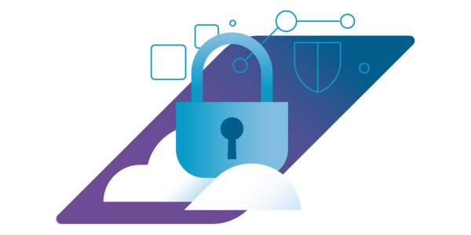
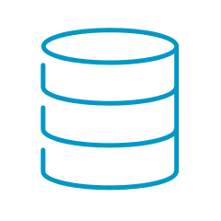
Achieving Compliance with the VCF 9 Security Configuration Guide
Overview
VCF 9 Security Configuration Guide
Audit
Modify
Total
VCF
0
9
9
ESX Hosts
68
48
116
vCenter
18
34
52
vSAN
3
11
14
NSX
2
12
14
Operations
1
20
21
226
Notes:
The VCF 9 Security Configuration Guide contains over two hundred security configuration recommendations.
VCF Base:
9 total controls that are relevant to multiple VCF products/components.
ESX Hosts:
116 controls for securing ESX hosts including 24 VM related controls.
vCenter:
52 vCenter controls.
vSAN:
14 vSAN controls.
NSX:
14 NSX controls for the NSX Manager and Edge Nodes.
Operations:
21 controls for VCF Operations, VCF Operations for Logs, VCF Operations for Networks and Fleet Management.
References:
https://github-vcf.devops.broadcom.net/vcf/Internal-VCF-Security
https://github.com/vmware/vcf-security-and-compliance-guidelines/tree/main/security-configuration-hardening-guide/cloud-foundation/9.0

Slide 8
Philosophy & Approach
VMware Cloud Foundation 9.0

Slide 9
Security in Cloud Foundation
Be Secure, Faster
All the capabilities you need to succeed, turned on and ready to use, flexible to meet any workload or environment’s needs.
Inherent Trust
Visibility into, and control of, the entire infrastructure stack is very important. Replace trust with continuous verification.
Recover Quickly
Resilience has always been the primary feature of VMware infrastructure products, whether you face a failed application upgrade or a natural disaster.
Notes:
Key Message:
Understand the three main goals of VCF security that make us different (and better) than the public cloud and other on-premises vendors.
Talk Track:
***ANIMATED***
When we think about cloud infrastructure security there are three main goals we are trying to achieve. First, we want you to be secure quickly, and stay that way. We provide all the capabilities you will need and turn them on by default, but also remain flexible to meet the needs of any workload. No security or compliance effort ever survives contact with real workloads, especially older ones, and having flexibility to meet their needs in a bespoke, tailored fashion is important. One size does not fit all with security.
**CLICK** The second thing we strive for is to drive trust in your infrastructure. And actually, one of the ways to do that is to replace trust with verification and validation, so that you know what the state of your environment is at any given time. You don’t have to take someone else’s word for it, because you control the situation from the ground up.
**CLICK** Third thing is to enable you to be resilient, easily. Resilience has been the primary feature of VMware products since 2005 when vMotion first shipped, and it’s finally getting attention with some of the new compliance standards, like DORA and NIS2. Being resilient to small problems, big problems, ransomware, hurricanes, system failures, disk failures, human error, and more is important, and with VCF you are well-equipped to deal with all of those situations.
Notes:
This is important to understand our approach to security. This space is large and talking about specific features can take days, so we approach it from the high level and drill in.
References:
https://brcm.tech/vcf-security, https://sales-resources.broadcom.com/group/vcf/security-compliance

Slide 10
CIA Triad: Core Tenets of Information Security
Confidentiality
Protecting systems & data from unauthorized people & groups
Integrity
Preventing modification of data by unauthorized groups & systems
Availability
Ensuring that data is available to authorized parties when needed
Notes:
Key Message:
Understand the three main pillars of information security as a foundation for our approach to security.
Talk Track:
One of the other ways we think about security in VCF is through the core tenets to information security, known as the CIA Triad.
Confidentiality means that unauthorized people don’t have access to your data. This is traditionally what people consider security, but there’s actually two other pillars that are really important, too…
…like integrity. Integrity means that our data doesn’t change on us, like if an attacker is able to deposit malware on systems. It also means that we have protections from things that aren’t an attack, per se, like a failing storage device which corrupts data while it fails.
Last is availability. If our data isn’t available to us when we need it, what’s the point of these systems? Availability problems can come from things like ransomware, or even from day-to-day work going on, and we can
Notes:
This is important to understand our approach to security. Many IT practitioners do not actually think in this way, and a short overview is helpful as a foundation for both security and compliance.
References:
https://brcm.tech/vcf-security, https://sales-resources.broadcom.com/group/vcf/security-compliance

Slide 11

Confidentiality
VM Encryption
Virtualization-Based Security
Intel vSGX
CPU Vulnerability Mitigations
AMD SEV-ES
Identity Federation
vSAN Transport Encryption
Distributed Switch Security
Every Feature is a Security Feature
Native Key Provider
FIPS 140-3
vSAN Encryption
Encrypted Configuration
TLS 1.3 & Certificates
Encrypted vMotion
NSX/ vDefend
DRS
Secure Boot
TPM & vTPM
Network Health Check
NTP & PTP
Lifecycle Manager
SIOC
vSAN Stretched Clusters
Code Signing
Live Recovery
Snapshots
Fault Tolerance
vCenter HA
EVC
Host Attestation
Skyline Health
VM Sandbox
vMotion
NIOC
Aria Operations
Integrity
Audit Logging
High Availability
HCX
Availability
NIAP/CC Certification
Storage vMotion
Cross vCenter vMotion
Configuration Profiles
Notes:
Key Message:
Understand how the three main pillars of information security inform the VCF feature set itself.
Talk Track:
***ANIMATED***
Seen through the lenses of the CIA triad, every feature in Cloud Foundation can be mapped to one or more of those pillars.
**CLICK** This certainly isn’t a complete list of features, but you get the idea here – every feature is, in some way, a security feature, and even more importantly…
Notes:
Not a complete list of features and functionality. Wouldn’t fit on the slide.
References:
https://brcm.tech/vcf-security, https://sales-resources.broadcom.com/group/vcf/security-compliance

Slide 12
Confidentiality
VM Encryption
Virtualization-Based Security
Intel vSGX
CPU Vulnerability Mitigations
AMD SEV-ES
Identity Federation
vSAN Transport Encryption
Distributed Switch Security
Security is an Inherent Property of VCF
Native Key Provider
FIPS 140-3
vSAN Encryption
Encrypted Configuration
TLS 1.3 & Certificates
Encrypted vMotion
NSX/ vDefend
DRS
Secure Boot
TPM & vTPM
Network Health Check
NTP & PTP
Lifecycle Manager
SIOC
vSAN Stretched Clusters
Code Signing
Live Recovery
Snapshots
Fault Tolerance
vCenter HA
EVC
Host Attestation
Skyline Health
VM Sandbox
vMotion
NIOC
Aria Operations
Integrity
Audit Logging
High Availability
HCX
Availability
NIAP/CC Certification
Storage vMotion
Cross vCenter vMotion
Configuration Profiles
Notes:
Key Message:
Understand how the three main pillars of information security inform the VCF feature set itself.
Talk Track:
Put another way, security is an inherent property of Cloud Foundation. It’s baked in and not bolted on after the fact.
Notes:
Not a complete list of features and functionality. Wouldn’t fit on the slide.
References:
https://brcm.tech/vcf-security, https://sales-resources.broadcom.com/group/vcf/security-compliance

Slide 13
Security at Every Layer of Cloud Foundation
CLOUD FOUNDATION
LIFECYCLE
ENFORCEMENT
MONITORING
THREAT DETECTION
RECOVERY
WORKLOADS
vTPM
VBS
HA & FT
INTEL SGX
AMD SEV-ES
REPLICATION
vSAN
ENCRYPTION AT REST
ENCRYPTION IN FLIGHT
STRETCHED CLUSTERS
FLEXIBLE POLICIES
vCENTER
ATTESTATION
VM ENCRYPTION
IDENTITY & RBAC
vMOTION & DRS
KEY MGMT
HYPERVISOR
CODE SIGNING
ENCRYPTION
LOCKDOWN
CPU & MMU
VM SANDBOX
ZEROING
HARDWARE
SECURE BOOT
HARDWARE TPM
RELIABLE MEMORY
AMD SEV-ES
INTEL TXT
Notes:
Key Message:
Security isn’t bolted on to VCF, it’s baked in at every layer of the stack
Talk Track:
If every feature in VCF is a security feature we could spend days talking about it (and if you’d like that, let us know!). But you get the idea, though – good security is in every layer of the stack, from the hardware itself, up to the hypervisor, through storage and vCenter, protecting workloads, and enabling ease of management at the Cloud Foundation level. We do this because threats exist at all those levels, and each level – both above and below – can help their neighbors out.
Notes:
Again, not a complete list of features and functionality.
References:
https://brcm.tech/vcf-security, https://sales-resources.broadcom.com/group/vcf/security-compliance

Slide 14



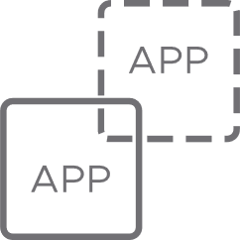
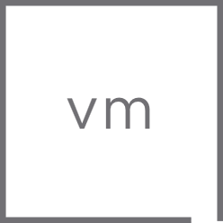
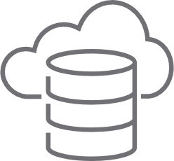



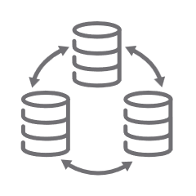
Resilience Woven Throughout VMware Cloud Foundation
Dependency
Mapping
Continuous Monitoring
Automated Patching
Data-at-Rest Encryption
VM Sandbox
Threat Detection
& Response
HCX
High Availability
Redeploy Modern App
Delta-Based
Failback
Identify
Protect
Detect
Respond
Recover
Trusted Computing Base
Application Load Balancing
Distributed Firewall
vMotion & DRS
Health
Checks
Intrusion Detection
Behavioral Analysis
VM Snapshot
Failover to
Recovery Site
Review, Audit
& Remediate
Host Attestation
Data-in-Transit Encryption
TPM & Secure Boot
Network Monitoring
Log Monitoring
Code Signing
Workload Clustering
Stretched Cluster
Isolated Recovery
Notes:
Key Message:
Security is important but resilience is the thing organizations really want, in the face of any sort of issue. The idea of resilience is woven into our platforms, and not an afterthought.
Talk Track:
And, this all ties back to operational resilience, which is really what most organizations want. The ability to use the platform to avoid, prevent, and recover quickly from issues, whether they are a failed application update, human error, ransomware attack, or a hurricane, with predictable results and costs, has been a hallmark of VMware products for decades.
This is the US National Institute of Standards and Technology’s Cybersecurity Framework 2.0, which does a good job of enumerating the idea of resilience, and again mapping Cloud Foundation functionality to the different parts. The latest version of the cybersecurity framework depicts this as a circle, with one more concept that applies to everything: governance. Governance is very important in an organization, to make sure that what the organization is doing aligns with its mission, ensure that processes are followed, inventory is kept, and so on. Doubly so now with AI technology. Not only does Cloud Foundation have all these deep resilience features, but it also has powerful governance tools through components like Aria Automation.
Notes:
Again, not a complete list of features and functionality.
References:
https://brcm.tech/vcf-security, https://sales-resources.broadcom.com/group/vcf/security-compliance

Slide 15
Layered Defenses
VMware Cloud Foundation 9.0
Notes:
Key Message:
Security inside Cloud Foundation is layered, both for flexibility and for defense-in-depth.
Talk Track:
So what does this security look like inside the product stack itself?
We create defense-in-depth by weaving a web of security features at every level of Cloud Foundation. There’s a metaphor that is used in the infosec space, comparing defense in depth to slices of Swiss cheese. You line up the layers so that the holes don’t match up and you can detect and prevent things from passing through.
Notes:
N/A
References:
https://brcm.tech/vcf-security, https://sales-resources.broadcom.com/group/vcf/security-compliance

Slide 16
Secure Boot Hardware TPM Reliable Memory AMD SEV-ES Intel TXT
Hardware
Hardware
Hardware
Notes:
Key Message:
Security inside Cloud Foundation is layered, both for flexibility and for defense-in-depth.
Talk Track:
At the hardware layer itself we take advantage of Secure Boot, Trusted Platform Modules or TPMs, hardware features like Reliable Memory, and CPU-level trust and data protections where they are enabled. Secure Boot and the capabilities of the TPM are important tools to prevent malware on hosts themselves.
Notes:
N/A
References:
https://brcm.tech/vcf-security, https://sales-resources.broadcom.com/group/vcf/security-compliance

Slide 17
Code Signing
Encrypted Configuration
Lockdown Mode
Hardware Vulnerability Protection
VM Sandbox
Memory Zeroing
Secure Boot Hardware TPM Reliable Memory AMD SEV-ES Intel TXT
Hardware
Hardware
Hypervisor
Notes:
Key Message:
Security inside Cloud Foundation is layered, both for flexibility and for defense-in-depth.
Talk Track:
Going up a level, ESXi builds on the foundation by enabling signed code execution, helping to ensure that binaries that run on the platform were installed from trusted sources.
ESXi encrypts its configuration data, avoiding writing secrets into the clear on flash media (which is effectively unsanitize-able).
ESXi seals its encryption keys and other secrets into the TPM, making them very difficult to retrieve and aiding customers with hardware lifecycle operations.
CPU vulnerabilities are flaws in the CPU hardware, and aren’t VMware’s problem, per se, but we have different CPU schedulers to help customers balance the performance impacts of those issues, whether they want to ignore them completely or remediate them fully.
Last on this list, ESXi encapsulates workloads in what we call the “sandbox” which is effectively a firewall for system calls to the hypervisor. If an attacker does something unexpected the sandbox will notice and shut the VM down.
Notes:
N/A
References:
https://brcm.tech/vcf-security, https://sales-resources.broadcom.com/group/vcf/security-compliance

Slide 18
Host Attestation
Role-Based Access Control
VM & vSAN Encryption
Identity Federation
vMotion, DRS, HA, FT
Code Signing
Encrypted Configuration
Lockdown Mode
Hardware Vulnerability Protection
VM Sandbox
Memory Zeroing
Secure Boot Hardware TPM Reliable Memory AMD SEV-ES Intel TXT
Hardware
Hardware
vCenter
Notes:
Key Message:
Security inside Cloud Foundation is layered, both for flexibility and for defense-in-depth.
Talk Track:
Going up another level, adding vCenter to ESXi to make it what was traditionally known as vSphere, we get other capabilities. We can use the combination of Secure Boot with the Trusted Platform Modules for Measured Boot and determine if the boot configuration of the host is valid or not. If it is, vCenter can attest it, and if it isn’t we can issue alarms to have a human come along and fix it.
vCenter adds a robust set of permissions as role-based access control, helping ensure that you can give people only the privileges they need.
vCenter adds the capability to do VM and vSAN encryption for data-at-rest protections, either using an external KMS or entirely within VCF using Native Key Provider.
The identity federation and services in vSphere enable customers to attach their environments to LDAP sources, as well as use ADFS or Okta or Entra ID or Ping sources directly, enabling multifactor authentication. This can also be done across the whole VCF suite.
Last, we also get things like vMotion, DRS, High Availability, and Fault Tolerance, which we often don’t think about as security features, but they absolutely are. Recall that information security’s three main tenets are confidentiality, integrity, and availability – known as the CIA triad -- and those features speak to availability. They also enable patching, which is the only way to remove a vulnerability from an environment.
Notes:
N/A
References:
https://brcm.tech/vcf-security, https://sales-resources.broadcom.com/group/vcf/security-compliance

Slide 19
Data Protection
Encryption at Rest
Encryption in Transit
Stretched Clusters
Granular, Flexible Fault Protection Policies
Host Attestation
Role-Based Access Control
VM & vSAN Encryption
Identity Federation
vMotion, DRS, HA, FT
Code Signing
Encrypted Configuration
Lockdown Mode
Hardware Vulnerability Protection
VM Sandbox
Memory Zeroing
Secure Boot Hardware TPM Reliable Memory AMD SEV-ES Intel TXT
Hardware
Hardware
vSAN
Notes:
Key Message:
Security inside Cloud Foundation is layered, both for flexibility and for defense-in-depth.
Talk Track:
vSAN has a ton of data protection capabilities, more than we can cover in a single slide. The newest Data Protection features are pretty nice, allowing remote storage of snapshots, as well as very efficient snapshot storage, so that you can protect against many issues like a failed application update, guest OS patching risks, and more.
There’s encryption at rest in vSAN, and it is incredibly easy to enable. There’s also encryption in transit, so instead of figuring out complicated network isolation and encryption… it’s just a simple switch. Turn it on, move on with your life. These two features have saved organizations immense amounts of time and money and made what looked like a hard problem into a really easy one.
Stretched clusters let organizations configure replication and fault domains which work with vSphere High Availability and DRS to ensure your data is always protected, again in a way that takes very little staff time to maintain.
And the flexibility of vSAN policies make it a terrific choice. Not all workloads are the same, so you can save money by assigning them different storage policies, and ensure compliance with things like data-at-rest encryption by simply defining it in the policy and letting the system figure it out.
Notes:
N/A
References:
https://brcm.tech/vcf-security, https://sales-resources.broadcom.com/group/vcf/security-compliance

Slide 20
vTPM
Replication & Snapshots
Virtualization-Based Security
Confidential Computing
High Availability
Data Protection
Encryption at Rest
Encryption in Transit
Stretched Clusters
Granular, Flexible Fault Protection Policies
Host Attestation
Role-Based Access Control
VM & vSAN Encryption
Identity Federation
vMotion, DRS, HA, FT
Code Signing
Encrypted Configuration
Lockdown Mode
Hardware Vulnerability Protection
VM Sandbox
Memory Zeroing
Secure Boot Hardware TPM Reliable Memory AMD SEV-ES Intel TXT
Hardware
Hardware
Workloads
Notes:
Key Message:
Security inside Cloud Foundation is layered, both for flexibility and for defense-in-depth.
Talk Track:
On top of all of this most organizations run workloads, and we have some workload-specific things we offer. First, a virtual trusted platform module that helps the workloads store secrets securely.
We can replicate workload data either using the vSphere Replication tools, or Live Recovery Site Recovery, or using the vSAN stretched clusters we just talked about. There are also snapshots which can help de-risk certain types of operations like workload patching and updates.
Virtualization-Based Security is a Microsoft tool that we support and enables Device Guard and Credential Guard, so that Windows guests can be very secure.
We support confidential computing technologies like AMD SEV-SNP and SEV-ES, and Intel TDX and SGX.
Last, we can do high availability for a workload at the platform level, either using vSphere HA or the vSphere Kubernetes Services, too.
Notes:
N/A
References:
https://brcm.tech/vcf-security, https://sales-resources.broadcom.com/group/vcf/security-compliance

Slide 21
Whole-Stack Lifecycle
Configuration Drift Management
Centralized Certificates, Identity Configuration
Managed Password Rotations
vTPM
Replication & Snapshots
Virtualization-Based Security
Confidential Computing
High Availability
Data Protection
Encryption at Rest
Encryption in Transit
Stretched Clusters
Granular, Flexible Fault Protection Policies
Host Attestation
Role-Based Access Control
VM & vSAN Encryption
Identity Federation
vMotion, DRS, HA, FT
Code Signing
Encrypted Configuration
Lockdown Mode
Hardware Vulnerability Protection
VM Sandbox
Memory Zeroing
Secure Boot Hardware TPM Reliable Memory AMD SEV-ES Intel TXT
Hardware
Hardware
Operations
Notes:
Key Message:
Security inside Cloud Foundation is layered, both for flexibility and for defense-in-depth.
Talk Track:
Finally, we get up to the level of Cloud Foundation, with the addition of SDDC Manager. SDDC Manager manages the whole fleet together, to drive standardization and patching in common ways across your whole enterprise.
Notes:
N/A
References:
https://brcm.tech/vcf-security, https://sales-resources.broadcom.com/group/vcf/security-compliance

Slide 22

Whole-Stack Lifecycle
Configuration Drift Management
Centralized Certificates, Identity Configuration
Managed Password Rotations
vTPM
Replication & Snapshots
Virtualization-Based Security
AMD SEV-ES & Intel SGX
High Availability
Data Protection
Encryption at Rest
Encryption in Transit
Stretched Clusters
Granular, Flexible Fault Protection Policies
Host Attestation
Role-Based Access Control
VM & vSAN Encryption
Identity Federation
vMotion, DRS, HA, FT
Code Signing
Encrypted Configuration
Lockdown Mode
Hardware Vulnerability Protection
VM Sandbox
Memory Zeroing
Secure Boot Hardware TPM Reliable Memory AMD SEV-ES Intel TXT
Hardware
VCF
Notes:
Key Message:
Security inside Cloud Foundation is layered, both for flexibility and for defense-in-depth.
Talk Track:
Finally, we get up to the level of Cloud Foundation, with the addition of SDDC Manager. SDDC Manager manages the whole fleet together, to drive standardization and patching in common ways across your whole enterprise.
Notes:
N/A
References:
https://brcm.tech/vcf-security, https://sales-resources.broadcom.com/group/vcf/security-compliance

Slide 23



̵
You are secure, compliant, and resilient
FASTER and
SPEND LESS TIME
on the process, with less complexity and more inherent, provable trust.
Notes:
Key Message:
Organizations that use Cloud Foundation spend less time securing things, and more time being secure.
Talk Track:
At the end of the day organizations that use Cloud Foundation spend less time chasing security, and more time actually being secure and resilient. That’s important, because security is all overhead. That isn’t to say it’s not important – it’s very important – but it rarely is the primary mission of the organization. It’s more like an insurance policy. You’ve seen that Cloud Foundation has a deep bench of tools to help organizations get this stuff done, with features enabled by default, and designed intentionally to be very easy to use and maintain.
And, when your security and resilience is good, it’s also easy to explain – and show -- to auditors for your regulatory compliance validations, so you can keep your organization moving forward.
Notes:
N/A
References:
https://brcm.tech/vcf-security, https://sales-resources.broadcom.com/group/vcf/security-compliance

Slide 24
What’s New
VMware Cloud Foundation 9.0
Notes:
Talk Track:
Let’s look at some of what’s new in VMware Cloud Foundation 9.0.
Notes:
N/A
References:
https://brcm.tech/vcf-security, https://sales-resources.broadcom.com/group/vcf/security-compliance

Slide 25
Faster, Easier Updates and Patch Remediation
Patching & Lifecycle Improvements
Multi-Vendor Cluster Images
HA & NSX VIBs now part of ESX
Improved vMotion for vGPU
Live Patch for vmkernel & daemons
Custom EVC Profiles
Notes:
Talk Track:
You all know that we have been transitioning from Update Manager to Lifecycle Manager over the last couple major versions. That transition is complete in 9.0, and incorporates an absolute ton of feedback from customers to make it a great way to manage the state of your clusters. To start, acknowledgement that not all clusters look the same, and sometimes you need to have different hardware in the same cluster. That works well now.
One of the trouble spots for years during updates was with add-ons, and coordinating the updates for those. In particular, we often recommended that HA be disabled during patching. No need for that now. All that stuff ships with the base ESX image itself, and is patched together, which is great. Also means it is tested together, too.
We started working on operational support for GPU-enabled workloads 10 years ago, basically foreseeing the future with these LLMs and AI, and it means that VCF is a terrific platform to run those types of workloads. We keep making it better, too – the ability to vMotion a GPU workload is an amazing thing for IT operations teams, preventing them from having to go negotiate to take a workload offline. Just move it. And capabilities like those keep getting better.
Live Patching – we introduced it in vSphere 8 Update 3, and we’ll talk about it in a second.
Finally, custom EVC profiles. EVC is Enhanced vMotion Compatibility and many organizations don’t use it, because if you didn’t turn it on right away when you built a cluster it was hard to turn on. Plus, CPUs now all are a little different. So you can define a custom EVC profile now based on your actual CPU and apply it to VMs that booted on those CPUs with the native feature sets. Problem solved.
There are many other improvements to patching as well, these are just the ones that I like the most from a security perspective. Patching is all overhead, and often unplanned, and we’re cognizant of that, which is why we’re trying to make it a low-effort and high-trust operation. Get it done, get back to normal.
Notes:
N/A
References:
https://brcm.tech/vcf-security, https://sales-resources.broadcom.com/group/vcf/security-compliance

Slide 26


Live Patch of ESX vmkernel and System Daemons
Security, Compliance, and Operational Resilience in VCF 9.0
Live Patch vmkernel, user-space and NSX components
ESX service restarts required (non-disruptive)
Fast-Suspend-Resume large vGPU VM even faster
No evacuation, VMs stay running.
ESX
vmkernel
user-space
nsx
vmx
Notes:
Presenter Note: [This slide contains animation]
Talk Track:
Live Patch is extended to more of the ESX image, including vmkernel and NSX components. Increasing the frequency that patches can leverage live patch.
NSX components, now part of the base ESX image, can be patched using the live patch process without hosts entering maintenance mode and needing VMs to evacuate the hosts.
Vmkernel, user-space and vmx (virtual machine execution) components can also leverage live patch. ESX services (for example hostd) might require a restart during a live patch which can cause ESX hosts to briefly disconnect from vCenter. This is expected behaviour and does not impact the running virtual machines. vSphere Lifecycle Manager reports what services or daemons will be restarted as part of the live patch remediation.
If the vmx (virtual machine execution) environment is being live patches, running VMs will perform a Fast-Suspend-Resume (FSR). Live patch is compatible with vSAN clusters. vSAN witness nodes are not compatible with live patch and will undergo full reboots when patching.
FSR performs significantly faster for vGPU enabled VMs. Previously FSR for two L40 GPUs each with 48GB memory would take ~84 seconds. Now this takes ~4 seconds.
Update releases (for example ESX 9 Update 1) are expected to require a full reboot as the entire ESX system is being updated.
Hosts using TPM and/or DPU devices are not compatible with live patching.
Notes:
1. Host enters partial maintenance mode
2. New mount revision loaded
3. New mount revision patched
4. VMs fast-suspend-resume to consume patched mount revision
Some virtual machines are not compatible with FSR. VMs configured with vSphere Fault Tolerance, VMs using Direct Path I/O and vSphere Pods cannot use FSR and need to be manually remediated. Manual remediation can either be done by migrating the virtual machine or by power cycling the virtual machine.
Virtual machines that do not support FSR include VMs configured for vSphere Fault Tolerance, VMs configured with VM DirectPath I/O devices, vSphere Pods (container pods).
These VMs must be manually migrated using vSphere vMotion or power cycled to pick up a new patched vmx instance.
Resources:

Slide 27

Defense-in-Depth Deep Down
Core Hypervisor Security Improvements
Code Signing Enabled, Alert Undismissable
Set Secure Boot via Config Manager
User-Level Monitor
vmkaccess sandboxes per daemon
SEV-SNP & TDX Initial Enablement
Notes:
Talk Track:
Remember the Swiss cheese metaphor I used earlier in this talk, to talk about defense-in-depth? We continue to improve things deep inside the stack itself to help add to those defenses. We have lots of stuff to stop attackers outside the infrastructure, but as much as we don’t like to admit it, sometimes they get in, and we want to make life very difficult for them so they have to do things that get noticed. No more creeping around inside systems.
We’ll talk about code signing and Confidential Computing in a second. As part of the patching and cluster management improvements we’ve made it so you don’t have to use that shell script on ESX to enable secure boot anymore. It’s an option in Configuration Manager. You still have to turn it on in your hardware firmware, but server vendors have that automated now – just call an API on the iDRAC or iLO and restart the host.
You’ll see mention of ULM – the User-Level Monitor. The Monitor is the term for the process that implements virtual machines, a virtual machine monitor or VMM. When you SSH into an ESX host and type ‘ps’ you’ll see all those processes that correspond to the running VMs, and that’s it. In CPUs and also in operating systems, like ESX but also Linux and Windows, there are different security levels. The two main levels or modes are kernel mode and user mode. Kernel mode is privileged, and has access to the whole system. User mode does not have access to the whole system. You might say “well, why don’t we use user mode then?” but, like everything in security, there are tradeoffs with performance and capabilities, and switching between modes slows things down. But, there have been a number of advancements with compute hardware that help that. So with 9.0 we are introducing a user-level monitor, where instead of running a VM as privileged, we can run it in user mode instead. That way, if something bad is going on inside the VM – think VM escape – we can contain it better because it doesn’t have privileged access to the system by default.
This is new, and you’ll only see it if you turn on Memory Tiering or Confidential Computing. There are some advanced parameters you can set on ESX to turn it on manually if you want, but over the course of the next few releases our goal is to make it the default, and just as performant and capable as the older-style virtual machine monitor that’s been with us for decades. You shouldn’t notice any difference now, but we’re a cautious group of folks, and want to ease our way into it. But I mention it because, frankly, it’s pretty darn cool and a major step forward.
Another major step forward is what we call vmkaccess, or the sandboxes around processes on ESX. In the past that sandbox was reserved for the virtual machine monitor itself, and it’s worked really well. In fact, security researchers tell us it gets in their way, which is the whole point. We’ve extended that to all the other processes on ESX, too.
Notes:
N/A
References:
https://brcm.tech/vcf-security, https://sales-resources.broadcom.com/group/vcf/security-compliance

Slide 28
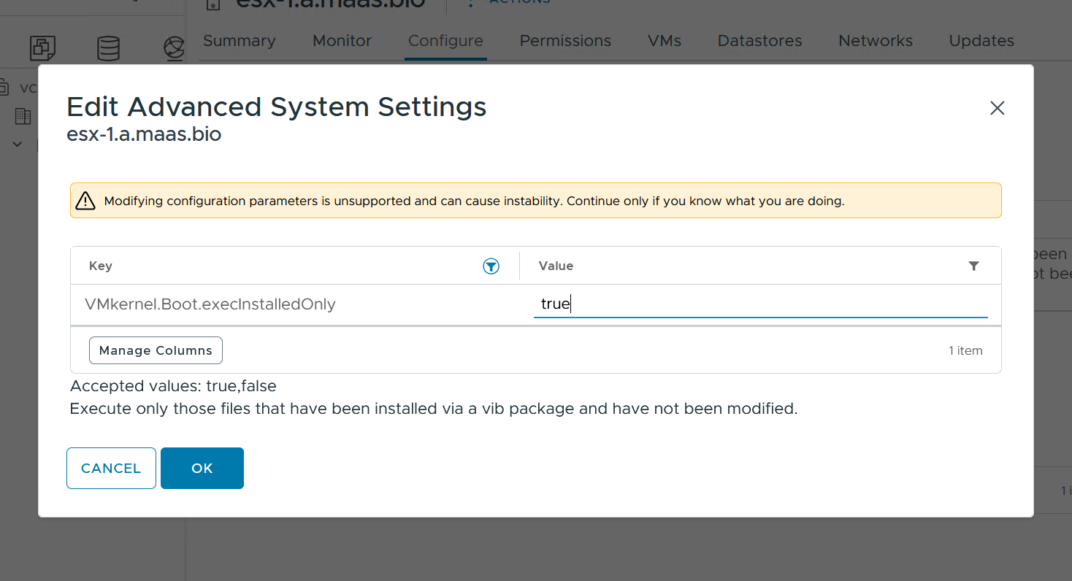
Preventing and Detecting Malware
Code Signing & execInstalledOnly Defaults
Single vmkernel Parameter, Enabled by Default
Requires Image Acceptance Profile set to anything but “Community Supported”
Not-Dismissible Alarm When Disabled
Notes:
Talk Track:
We’ve been talking about code signing enforcement on ESX for a few versions now, and it’s been a process on a few fronts, especially getting the whole ecosystem aligned with code signing. Our ecosystem is big, as you know, and that’s good but it comes with an inertia to it, too. So to do this we started with adding the option, then making it the default but it was still able to be shut off. Now we’re making it more enforceable. There’s only one parameter now, and you can still shut it off, but if you do there will be an undismissable warning that you have a security problem. Which is true. Anyone that tells you to shut it off should be told to sign their code correctly instead.
Notes:
N/A
References:
https://brcm.tech/vcf-security, https://sales-resources.broadcom.com/group/vcf/security-compliance

Slide 29
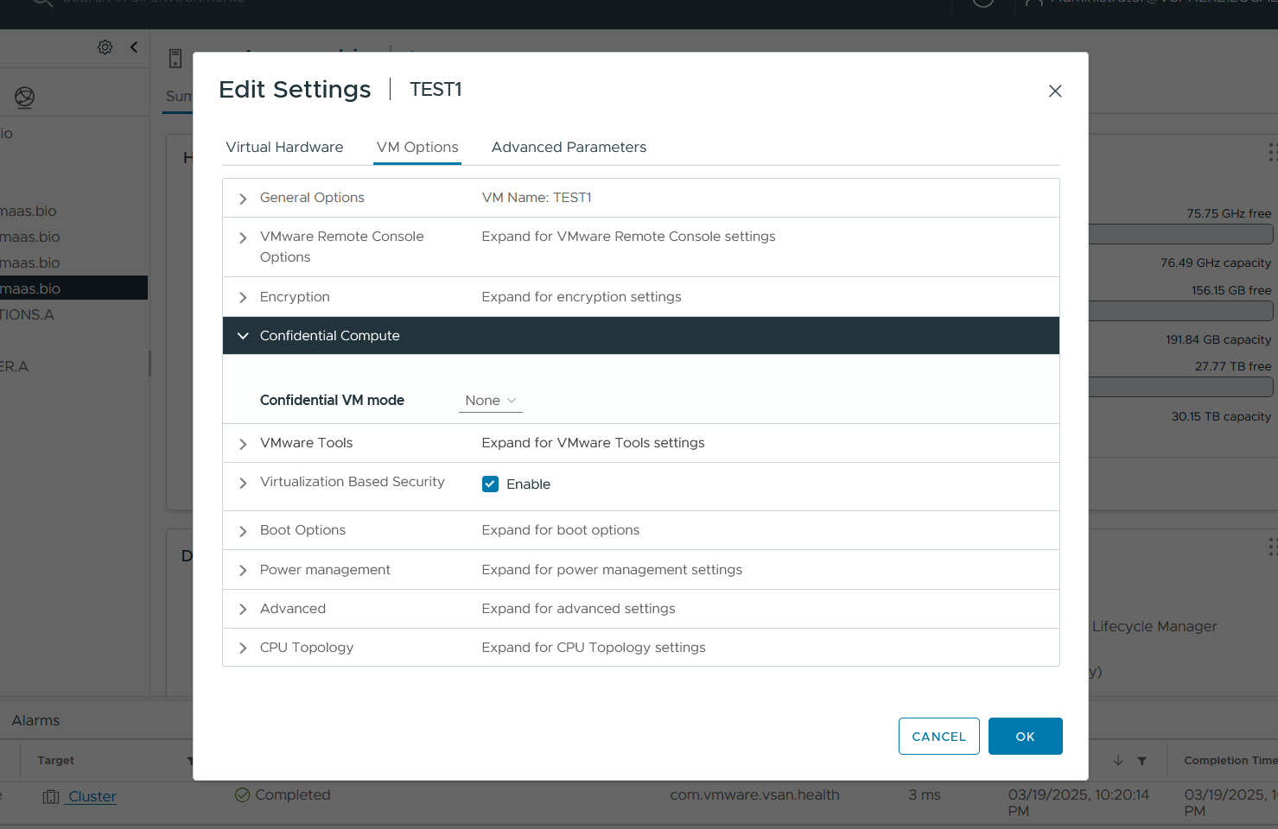
Initial Support for AMD SEV-SNP and Intel TDX
Confidential Computing in VCF 9.0
Initial steps to enable AMD SEV-SNP and Intel TDX protections
Requires host hardware support enabled in firmware
Initial support implementation; prevents vMotion and other hypervisor features
Much more to come!
Notes:
Talk Track:
One big thing we’ve added to VCF 9.0 is more Confidential Computing capabilities, specifically the initial support for AMD SEV-SNP and Intel TDX. If you aren’t familiar with it, Confidential Computing is an attempt to not trust the hardware you run on, by using encryption and code signing and attestation. Confidential Computing is something that you hear a lot about in the public cloud space, because public cloud providers really need you to trust them, often quite blindly, and things like hardware vulnerabilities where information leaks between workloads are sometimes impossible to mitigate in those environments. So how can you protect yourself from a malicious neighboring VM on a shared host? You need something more.
VMware environments don’t typically have that problem, because the whole compute stack can be managed by you, and that builds trust. You know what’s been mitigated in server firmware because you’re able to directly verify it. We've had support for SEV-ES and SGX for quite a while now, but adoption of those technologies has been low. That’s for a couple reasons, but mostly because they really curtail infrastructure operations by blocking vMotion and other platform services. That makes sense, though. These technologies are intended to keep secrets, and unfortunately when you keep secrets from the hypervisor it can’t help you.
Which is why both AMD and Intel have follow-on tech -- SEV-SNP and TDX -- that allows the hypervisor to participate, so you can get some of those features back. That’s the path we’re on, and the first stop for us is core support for these technologies. We’re releasing it so people can use it if they want, but know that there’s more to come on this roadmap, because when the hypervisor can participate that’s a huge win for IT operations. Especially day-to-day resilience and operations like patching.
.
Notes:
N/A
References:
https://brcm.tech/vcf-security, https://sales-resources.broadcom.com/group/vcf/security-compliance

Slide 30
Taking Security Inside The Workload
Virtual Machine Security Improvements in VCF 9.0
Custom VM Secure Boot Certificates
Updated Revocation List
Hardened Virtual USB
Forensic Snapshots
Notes:
Talk Track:
All the infrastructure is great, but the whole point is to run workloads, right? And keeping them safe is a huge part of what we do, both from attack as well as being able to restore them.
One thing we’ve been asked about over the past couple years is the ability to use custom VM secure boot certificates. VMs work fine out of the proverbial box with commercial operating systems, but some organizations want to build their own Linux kernels, and have their own PKI infrastructure to sign them. We now have a straightforward way to support that.
Microsoft’s Black Lotus vulnerability – a problem where the signing key for Windows operating systems was leaked – has caused some changes in how Windows VMs need to boot. At Microsoft’s request we’ve updated the default Secure Boot certificate revocation list, which means that if you try to install Windows on a newer virtual hardware version VM you’ll need recent Microsoft install media. Not that big of a deal, but something to keep in mind when you wonder why it’s not booting.
Virtual USB is great but we’ve made a bunch of improvements, based on findings from security researchers. Another huge argument for keeping things up to date, both with VMware Tools drivers and virtual hardware versions.
Last on this list, forensic snapshots. We always want to guarantee that a snapshot of a VM can run the VM again, make it crash-consistent, which just means that it looks like the workload lost power. All OSes, databases, most apps know what to do in that situation. However, digital forensics and incident response teams really don’t need to run the VM again, they just want a snapshot that they can put in their analysis tools. We’ve made that easier to create for them, so VCF admins can get them what they need faster. This helps speed situations like recovery after an attack.
Notes:
N/A
References:
https://brcm.tech/vcf-security, https://sales-resources.broadcom.com/group/vcf/security-compliance

Slide 31
Making Certificate and Key Management Easier
Cryptography and Certificates in VCF 9.0
TLS 1.3 Default & Only
FIPS 140-3 & Cipher Suites
Non-Disruptive VCF Certificate Renewal
Encryption Key Wrapping
Notes:
Talk Track:
It always seems like we talk about certificates and cipher suites, but it’s changing. People are worried about post-quantum cryptography, compliance, and we’ve all got the CA/Browser forum saying that browsers will only honor certificates for 47 days moving forward. This means we need some automation. We’ll talk about TLS and FIPS and certificate management in a minute, but we continue to make certificate replacement non-disruptive throughout the stack so these tasks aren’t troublesome.
Notes:
N/A
References:
https://brcm.tech/vcf-security, https://sales-resources.broadcom.com/group/vcf/security-compliance

Slide 32
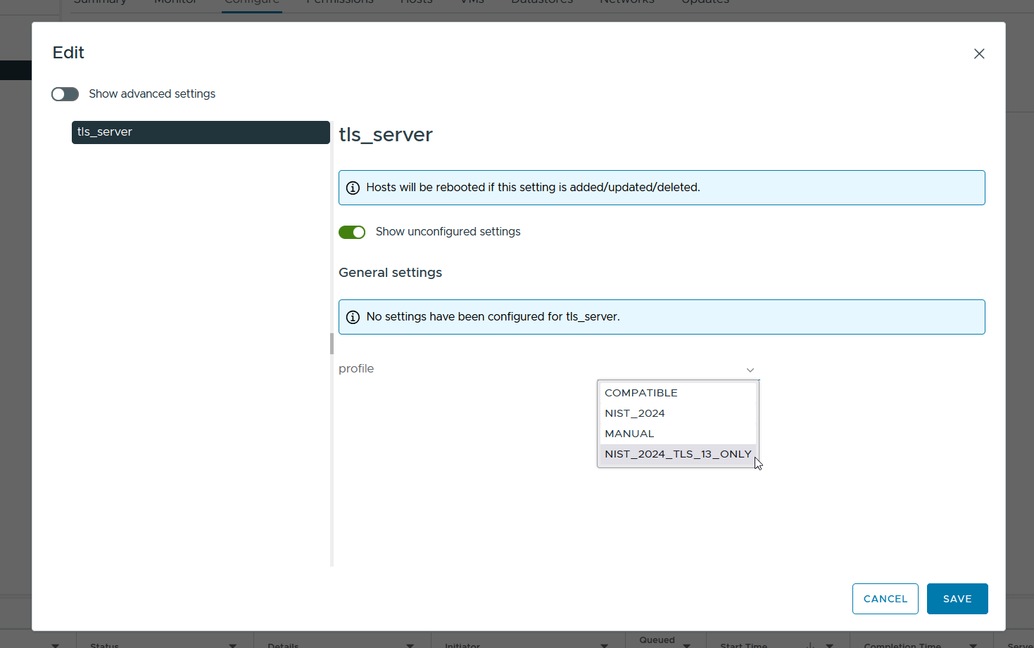
Modern Ciphers Speed Compliance Validations
TLS 1.3 and FIPS 140-3 Support in VCF 9.0
TLS 1.3 Available By Default on All Ports
Can limit ciphers to FIPS 140-3 best algorithms
Can also limit to only TLS 1.3:
TLS_AES_256_GCM_SHA384 TLS_AES_128_GCM_SHA256
Will have to find other things to talk about with GRC…
Notes:
Talk Track:
I promised I’d talk about TLS and FIPS. Let’s start with FIPS. As the US Government sunsets FIPS 140-2 we are re-validating everything against FIPS 140-3, and largely enabling it everywhere. There are some places it isn’t set up yet, but the documentation and our security GitHub repository has information on that.
TLS 1.3 is available everywhere, though, and it’s the default for communication inside VCF 9.0. TLS 1.2 is still there and responding by default, too, for backwards compatibility, but if you don’t need that you can shut it off. You do that by selecting the TLS Profile. NIST_2024 is the best TLS 1.3 and 1.2 ciphers, and NIST_2024_TLS_13_ONLY is… you guessed it… the same but TLS 1.3 only.
You’ll have to find something else to talk to the GRC auditors in your environment now. Sorry. I suggest sports, weather, or how difficult it is to keep up with the ever-changing state of global regulatory compliance.
Notes:
N/A
References:
https://brcm.tech/vcf-security, https://sales-resources.broadcom.com/group/vcf/security-compliance

Slide 33
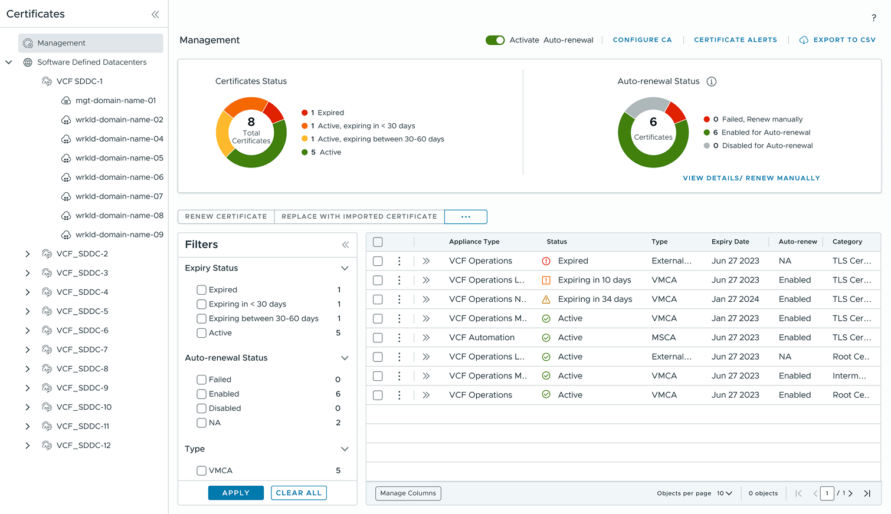
Centralized Certificate Management
Security, Compliance, and Operational Resilience in VCF 9.0
One interface to manage certificates for infrastructure components
Supports Microsoft AD CS, OpenSSL, and external CAs
Automatic renewal options
Non-disruptive architecture avoids having to schedule downtime
Notes:
Key Message:
VMware Cloud Foundation 9 Delivers A Powerful New Approach to Certificate Management
Talk Track:
In VMware Cloud Foundation 9, we're excited to introduce a completely revamped certificate management experience, bringing both the infrastructure and management components under one umbrella. Administrators now have greater flexibility in their certificate management approach, with the ability to leverage existing Microsoft Active Directory Certificate Services CAs, utilize the open-source OpenSSL for certificate generation, or even generate certificate requests for use with external CAs.
One of the key enhancements in VCF 9 is the automatic certificate renewal functionality when using integrated CAs. This streamlines the process, ensuring certificates are automatically renewed and replaced for compatible components, eliminating the need for manual intervention. The new certificate management infrastructure also integrates with VCF Operations alerts, providing timely notifications about expiring certificates and upcoming renewals, enabling proactive management and minimizing potential disruptions.
For organizations with high compliance requirements, VCF 9 also introduces the ability to issue signed certificates to VMware ESXi hosts. This ensures that your virtualized environment is compliant with the most stringent security standards, further bolstering your overall security posture.
Overall, VCF 9's certificate management capabilities represent a significant step forward in managing and securing your cloud infrastructure. This new approach delivers enhanced flexibility, increased automation, and improved compliance, ultimately making your cloud environment more secure and efficient.
Notes:
Resources:

Slide 34
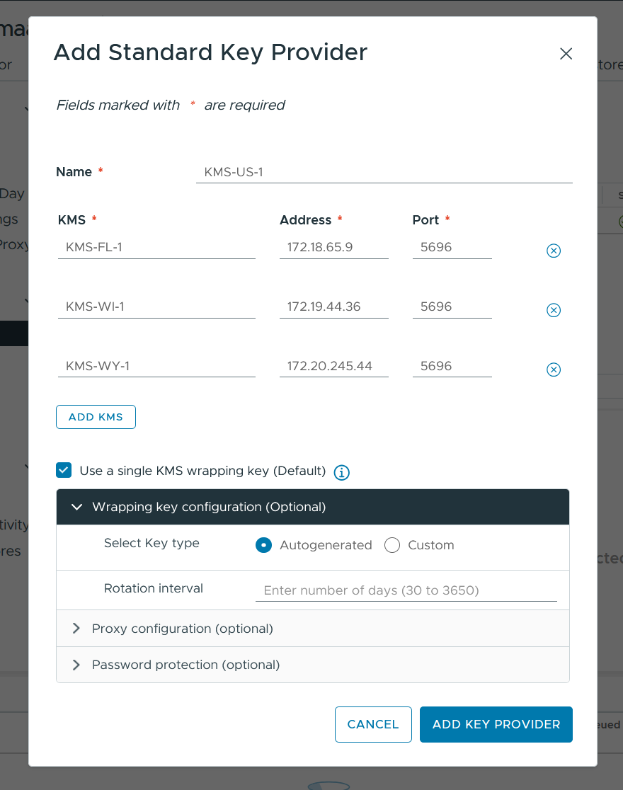
Key Wrapping
Store a single key in your KMS which wraps your Key Encryption Key (KEK)
Rotate automatically if desired
Can specify a custom key ID
Easy to rekey into this configuration using a non-disruptive “shallow rekey”
.
Broadcom Proprietary and Confidential. Copyright © 2025 Broadcom.
All Rights Reserved. The term “Broadcom” refers to Broadcom Inc. and/or its subsidiaries.
Notes:
One other really interesting thing we’ve added to VCF 9.0 is the ability to wrap the encryption keys with another key which is stored in a KMS. Right now when you use a standard Key Provider, accessing an external KMS, it will store a key per object in the KMS. With this new setup you can have it store only one key in the KMS, and then use that key to protect the object-level keys back in the VCF environment. Effectively you will have three keys associated with an encrypted object, the Data Encryption Key for the object’s data, the Key Encryption Key which protects the Data Encryption Key, and then the wrapping key which protects the Key Encryption Key.
There is automatic key rotation built into this as an option, from 30 days to 10 years, which helps a lot of organizations that need to rotate keys (which is a good idea). You can also specify a custom key ID, which is a feature people have asked for so that KMS admins can tell what keys belong to VCF.
One downside, though, is that you cannot just enable this on an existing key provider. However, you can create a new key provider and migrate to it, with all the VMs up and running, by doing a rekey. We have sample scripts for this in our security GitHub repository and it really works well.
Notes:
N/A
References:
https://brcm.tech/vcf-security, https://sales-resources.broadcom.com/group/vcf/security-compliance

Slide 35
Are You Really You? Prove It.
Identity Management in VCF 9.0
VCF-wide Unified Configuration
Multiple Deployment Options
Generic Identity Provider Support
Notes:
Talk Track:
Identity providers, or IdPs, are one of the main attack vectors used against IT infrastructure, and it doesn’t matter whether you’ve got on-premises solutions or cloud-based ones. The ability to integrate with modern IdPs to get multifactor authentication, conditional access, device hygiene, and more is really important, and you can set that up from VCF Operations now in 9.0. The components for this are the evolution of the vIDM tools that the Aria and vRealize suite used to use, and the original team that developed them is back on the case to bring their vision for it forward. There’s different ways you can deploy the identity brokers, from a simple embedded one in vCenter to a fully redundant, clustered architecture.
It also adds generic SAML and OAUTH2 support, so you can integrate whatever you’re using, not just the few providers we’ve certified (and those are all still there).
Notes:
N/A
References:
https://brcm.tech/vcf-security, https://sales-resources.broadcom.com/group/vcf/security-compliance

Slide 36
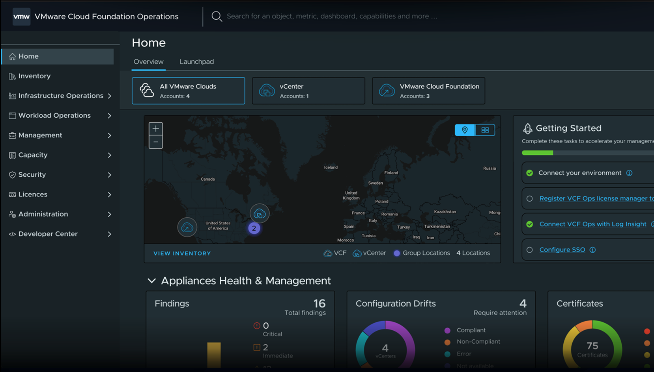
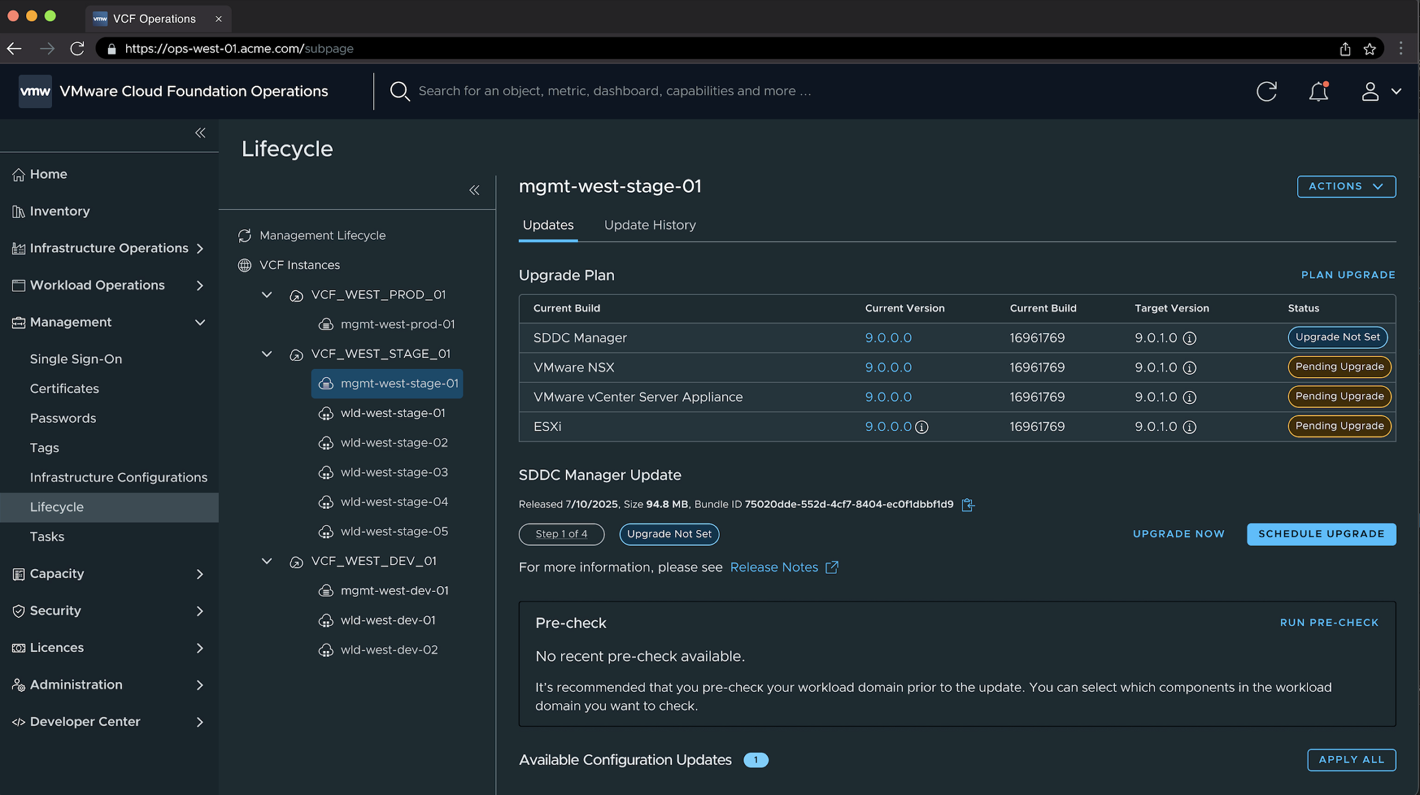

One Interface to Infrastructure Operations
36
Unified Admin Experience with the VCF Operations Console
New Build and Operate Experience
Quick Deployment: Accelerate setup with Quick Start.
Governance and Control: Manage costs and ensure policy adherence as you deploy and run applications.
Fleet Management at Scale
Simplified Lifecycle: Plan and schedule your patching and upgrades easily, across your fleet.
Unified Management: Centralize management of identity providers, passwords, tags, logs, and certificates.
Platform Security Operations
Proactive Diagnostics: Allows you to act quickly and send alarms when changes occur.
Application Insights: Analyze application behavior and create specific actions to ensure availability.
The image is for illustration only
VCF Operations Console
Notes:
Talk Track:
We’ve talked a bit about all of this, but the new VCF Operations interface is intended to be a one-stop shop for many security operations, from security configuration and alerting, log management and alerting, as well as your interface for consistent, fleet-wide patching and configuration operations. This was the vision of Cloud Foundation all along, and it’s really coming together as part of a set of unified tools. It’s exciting to see.
Notes:
N/A
References:
https://brcm.tech/vcf-security, https://sales-resources.broadcom.com/group/vcf/security-compliance

Slide 37
Removals & Changes
VMware Cloud Foundation 9.0
Notes:
Let’s look at some of what’s new in VMware Cloud Foundation 9.0. We’ll start with the removals, deprecations, and changes that might impact you in this space.
Notes:
N/A
References:
https://brcm.tech/vcf-security, https://sales-resources.broadcom.com/group/vcf/security-compliance

Slide 38
Deprecations & Removals
Security, Compliance, and Operational Resilience in VCF 9.0
CIM & SLP Removal
Update Manager Baselines
Block Manual Edit to SSH Configuration Files
Smart Card, RSA SecureID Support Removed From ESX
IWA Removed From vCenter
vSphere Trust Authority Removed
NPIV Removed
SIOC/SDRS for I/O Latency Removed
Notes:
Most of this list is a natural evolution of the product stack, to be honest.
Notes:
N/A
References:
https://brcm.tech/vcf-security, https://sales-resources.broadcom.com/group/vcf/security-compliance

Slide 39
Deprecations & Removals
Security, Compliance, and Operational Resilience in VCF 9.0
CIM & SLP Removal (Use Native APIs)
Update Manager Baselines (Use Lifecycle Manager Images)
Block Manual Edit to SSH Configuration Files (Defaults Are Secure)
Smart Card, RSA SecureID Support Removed From ESX (Federate)
IWA Removed From vCenter (AD over LDAPS, ADFS, Federate)
vSphere Trust Authority Removed (…)
NPIV Removed (VMFS Datastores)
SIOC/SDRS for I/O Latency Removed (VCF Operations)
Notes:
CIM & SLP weren’t being widely used, because everything just uses our native APIs. Plus the open source projects for those pieces of software became unmaintained.
Update Manager baselines are inferior to the Lifecycle Manager images, especially with all the recent improvements there.
SSH configurations… you can set those via esxcli if you need to. Which you likely don’t. Leave SSH off.
With regard to Smart Card and SecureID support on ESX, our stated intentions for the last two major releases have been to simplify authentication and identity management, and the VCF team working on that has done some terrific work. We want you to drive day-to-day operations through vCenter directly.
IWA has been removed from vCenter, too. You cannot domain join your vCenter anymore. That has become a dangerous idea anyhow. You can still do it to ESX, though, but we ask that you consider that carefully.
vSphere Trust Authority was deprecated in vSphere 8 Update 2 and removed in 9. There are some roadmap items to use its components in a more user-friendly way moving forward.
NPIV is N-Port ID Virtualization and it lets a VM pretend to be a full host on your SAN so storage can be allocated directly to it. Not widely used, not a great idea. Gone.
Storage I/O Control for I/O latency is also gone. Modern disk arrays are all flash and have removed the need for this, and it complicates things.
Notes:
N/A
References:
https://brcm.tech/vcf-security, https://sales-resources.broadcom.com/group/vcf/security-compliance

Slide 40
Methodology & Approach

Slide 41
VCF Platform Hardening
Use this slide if it is a hardening engagement
Methodology & Approach
Step 1
Step 2
Step 3
Step 4
Step 5
Due Diligence
Start up and Planning
Design Workshop
Implementation and Verification
Knowledge Transfer Workshop
Sign-off on deliverables
Identify key standards
Identify SPOC(s)
Create draft project schedule
Schedule kickoff meeting
Hold a kick-off meeting
Finalize the project schedule
Establish requirements for document handling
Finalize requirements and scope
Send OVA to security team
Conduct Design Workshop to plan implementation
Review controls in Configuration Workbook
Determine Action Needed and Suggested Value for controls
Determine implementation plan
Implement controls
Perform post implementation verification
Update Verification Workbook
Conduct Knowledge Transfer Workshop
Weekly Status Checkpoints and Open Communication

Slide 42
VCF Security Configuration Assessment
Use this slide if it is an assessment engagement
Methodology & Approach
Step 1
Step 2
Step 3
Step 4
Step 5
Due Diligence
Start up and Planning
Workshop and Review
Document Findings and Review
Deliver Results
Sign-off on deliverables
Identify key standards
Identify SPOC(s)
Create draft project schedule
Schedule kickoff meeting
Identify interviewees
Hold a kick-off meeting
Finalize the project schedule and interviews
Establish requirements for document handling
Request documentation
Finalize requirements and scope
Send OVA to security team
Run automated scans
Conduct technical workshops to review manual controls
Troubleshoot and remediate technical issues
Review and analyze documentation
Document findings and recommendations
Prepare draft assessment report
Review draft report with key stakeholders
Finalize assessment report
Conduct findings presentation
Weekly Status Checkpoints and Open Communication

Slide 43
Resources

Slide 44


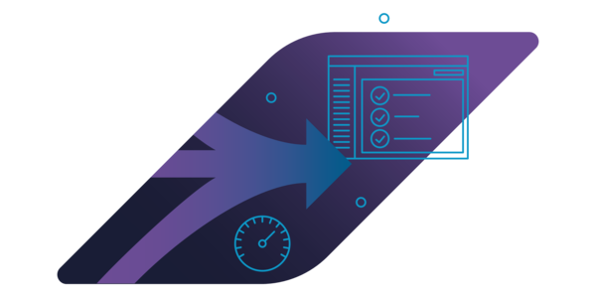
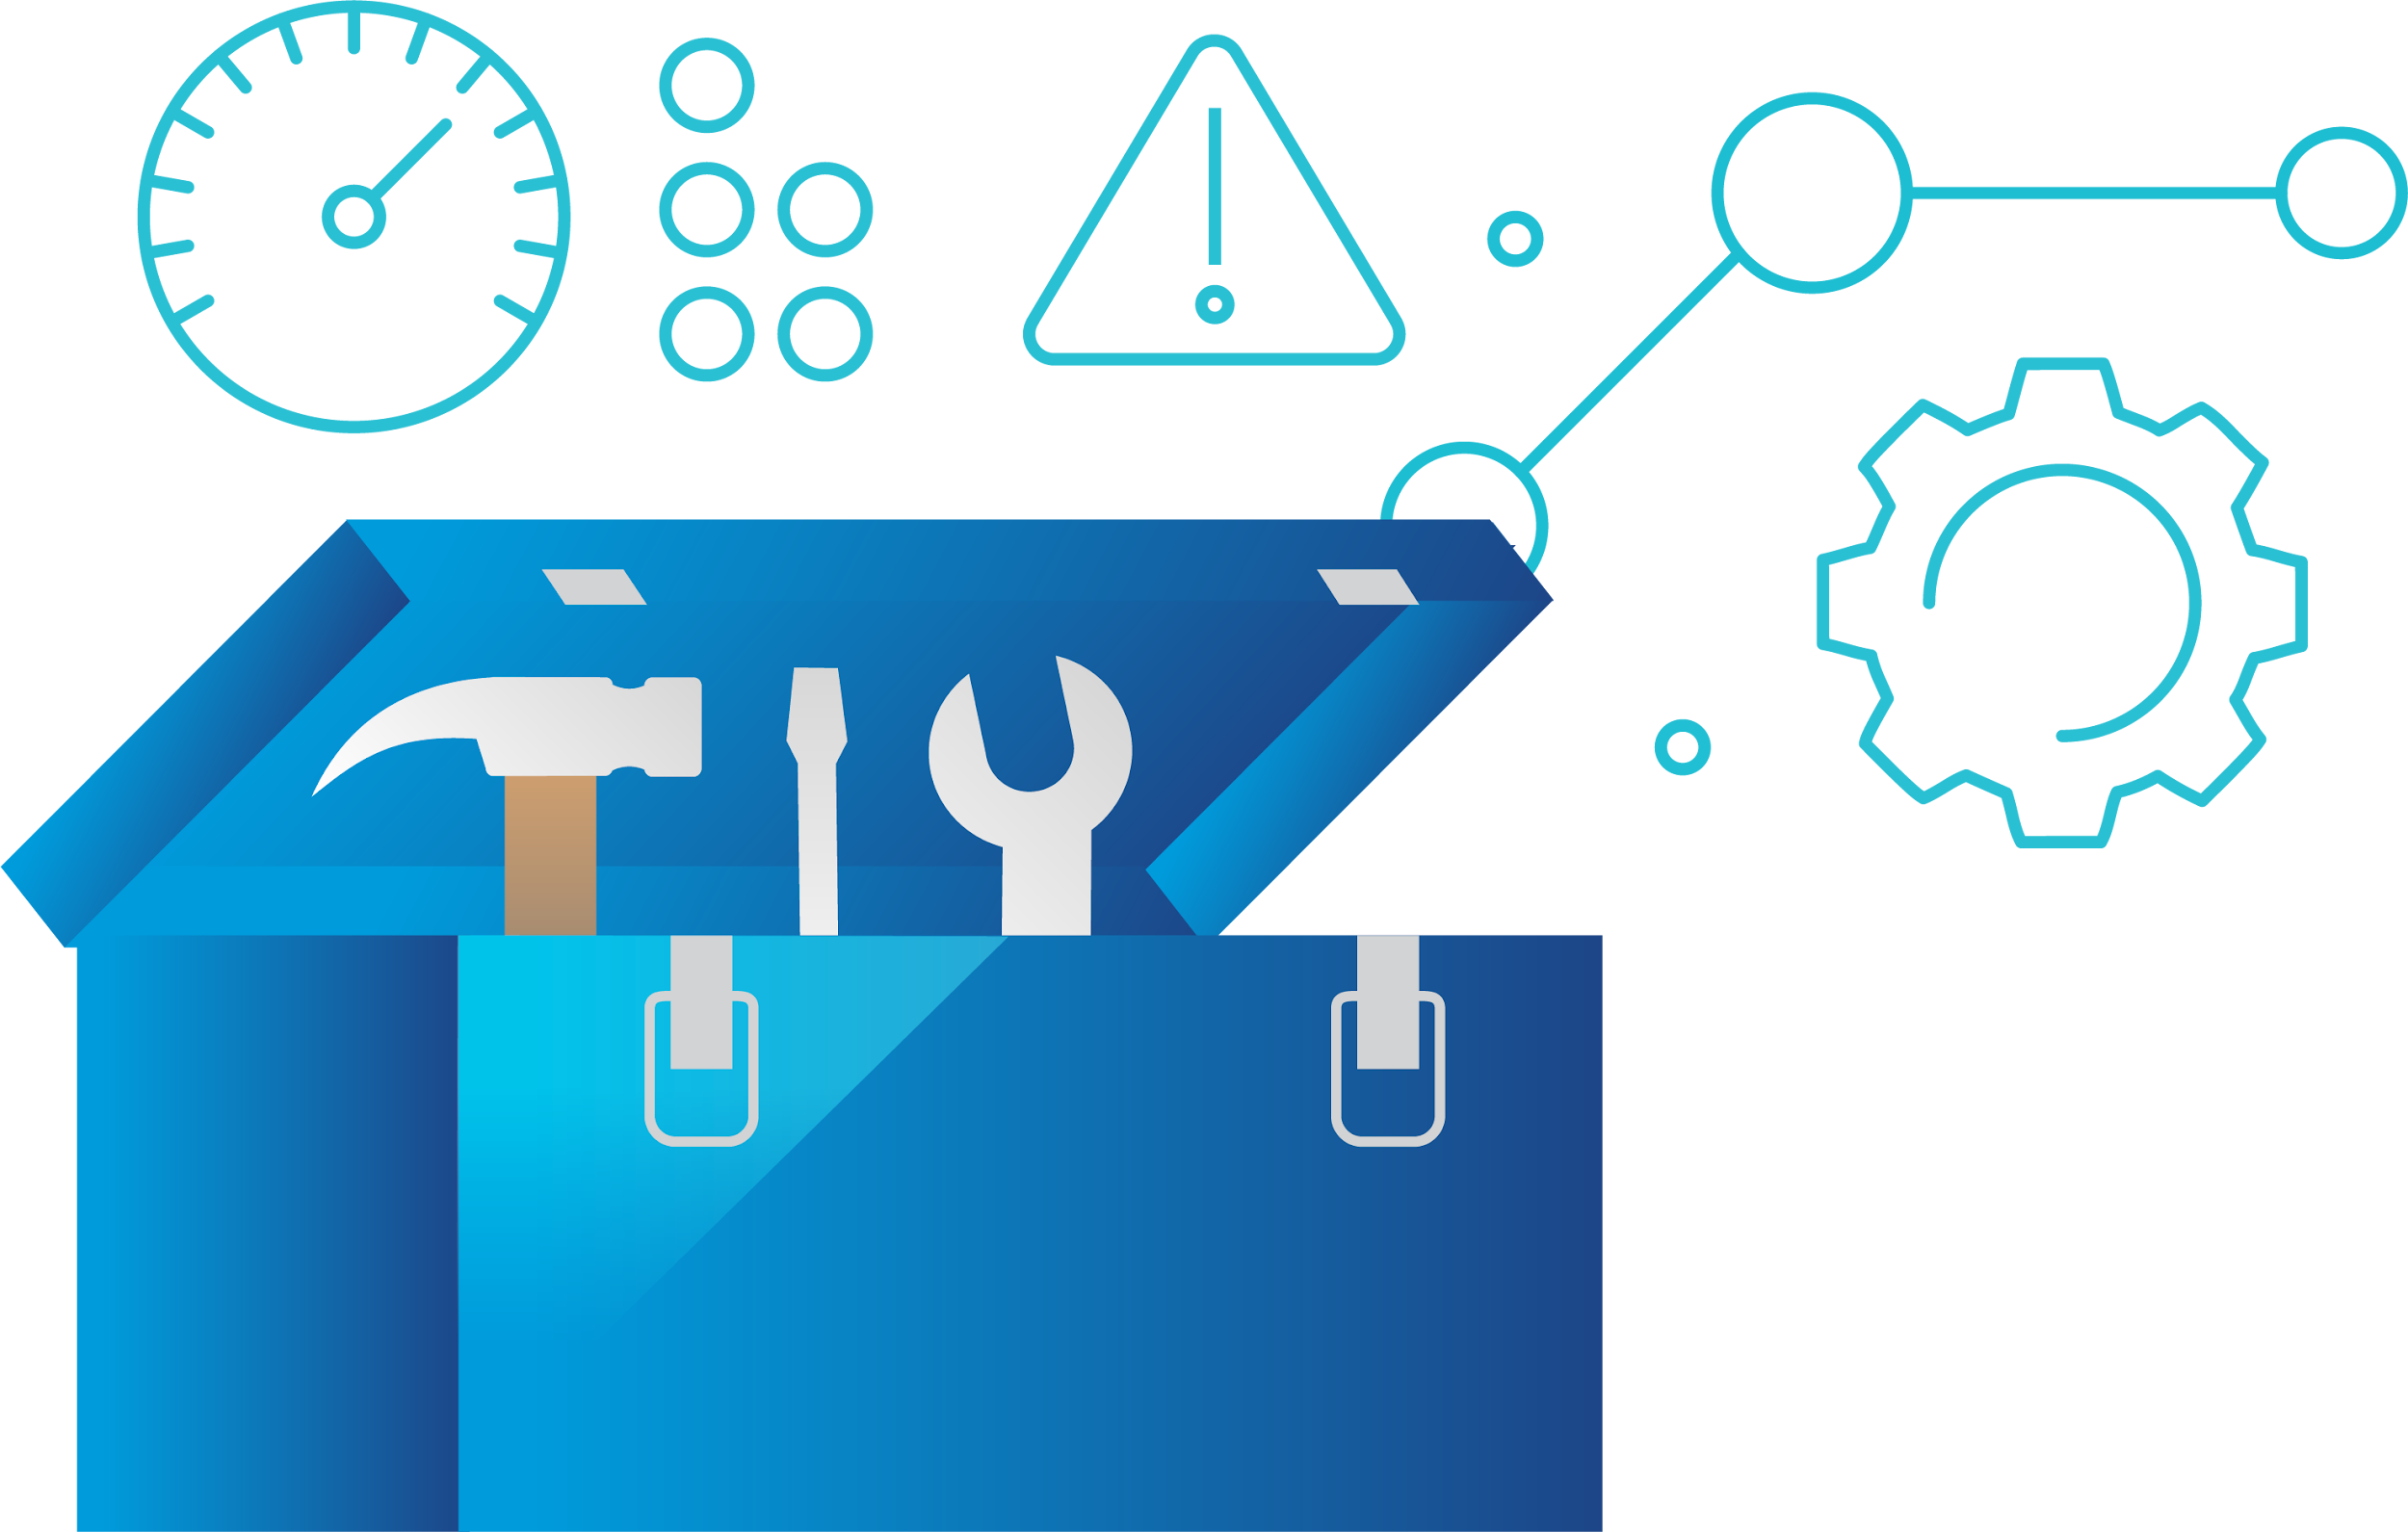

Resources
VCF Security 9.x - GitHub
VCF Security 9.x - Box
VCF Security Controls Database (SCD)
Security EDM
STIG Appliance
STIG Automation Documentation
Tooling
VCF PS Portfolio Assistance Google Space
Email us at: VCF-PSE.pdl@broadcom.com
Assistance

